Slide 1
CSC4005 Parallel Programming Tutorial 1
Bokai Xu, 119010355@link.cuhk.edu.cn

Slide 2
Tutorial Schedule
Tuesday 18:00-18:50 TA307
Wednesday 20:00-20:50 TA307
Other sessions are cancelled.

Slide 3
Office Hour Schedule
 | Time | Venue
Weibin Chen (TA) | 9:00-10:00 Wednesday | SDS office on the floor 4 of ZhiXin building
Yihan Liu (TA) | 19:00-20:00 Thursday | Online, zoom id: 613-456-4907
Yuxuan Liu (TA) | 20:00-21:00 Thursday | Online, zoom id: 394-118-1035
Bokai Xu and Zhixin Luoyang (USTF) | 21:00-22:00 Wednesday | TA307

Slide 4
Outline of Tutorial 1
About Linux
Basic Linux Commands
Development environment
CSC4005 Virtual Machine setup
C++ environment for parallel programs
Compiler for parallel programs
Run C++ parallel programs
HPC (High Performance Computing) cluster

Slide 5
Why linux
High performance computing clusters serve multiple users simultaneously, linux works well.
Linux are very friendly to cpp programming, a lot of cpp libraries provided on linux.
Linux has a small size and high efficiency.
...
20% of interviewees told us that they don’t know how to use linux. So we add a linux part.

Slide 6
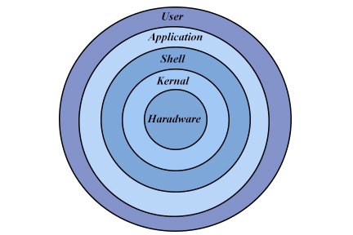
How to use linux?
What is your purpose to use Linux?
We want to utilize the capability of hardwares (like CPU, GPU, hard disk, network ...)
How to use?
Hardware is wrapped by linux kernel, and kernel is wrapped by shell (terminal). Terminal is an interface layer.
We can only use terminal.
Cite: http://generalnote.com/Linux-Tutorial/Introduction-to-Linux/basic-linux.php

Slide 7


The Matrix
The Matrix is a high performance computer, people who live in reality can only interact with the Matrix by using a terminal.
GUI Desktop is indeed a program running on Linux. It is a enchanced version of terminal. But it is essentially a terminal.

Slide 8
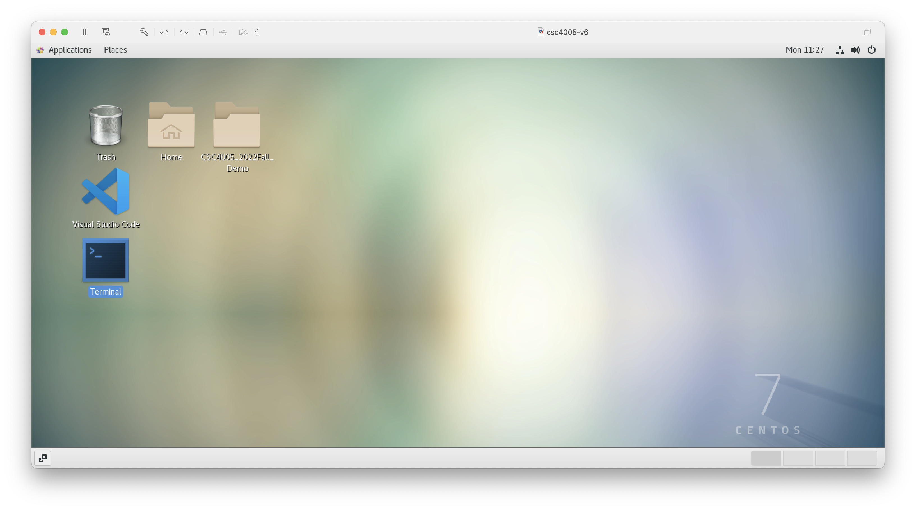
A classical terminal

Slide 9
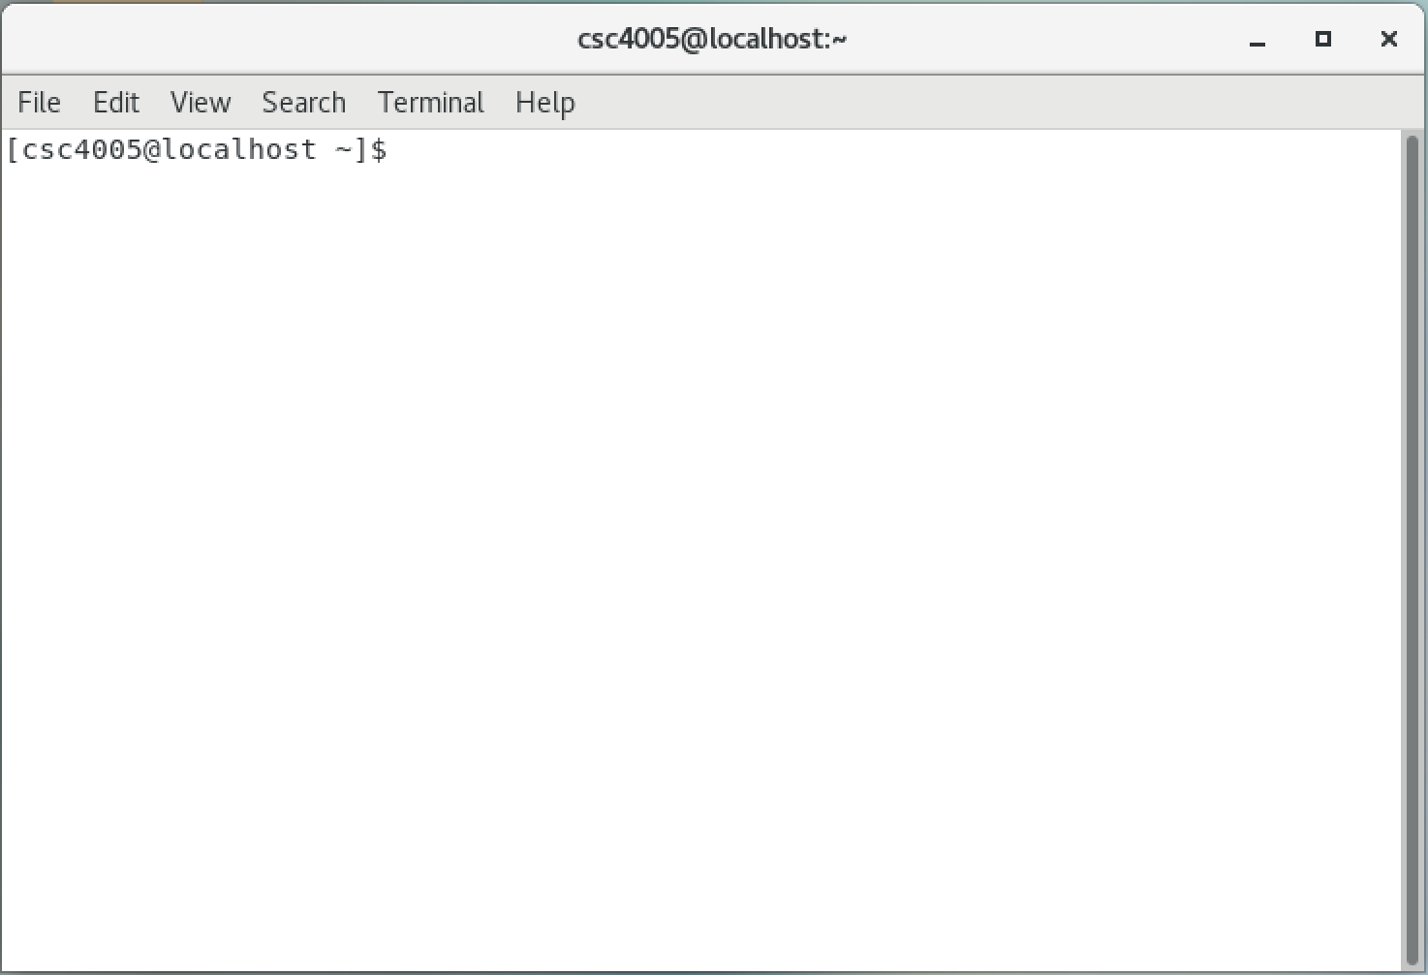
A classical terminal
user
Your current working directory: home directory (~)
You can write command here

Slide 10
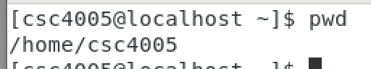
pwd
Use the pwd command to find out the path of the current working directory (folder) you’re in. The command will return an absolute (full) path, which is basically a path of all the directories that starts with a forward slash (/). An example of an absolute path is /home/username.

Slide 11
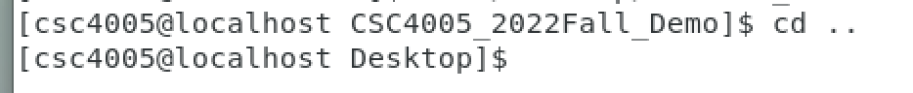
cd
To navigate through the Linux files and directories, use the cd command. It requires either the full path or the name of the directory, depending on the current working directory that you’re in.

Slide 12
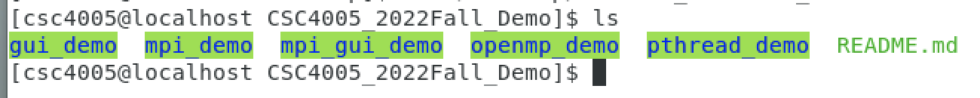
ls
The ls command is used to view the contents of a directory. By default, this command will display the contents of your current working directory.

Slide 13
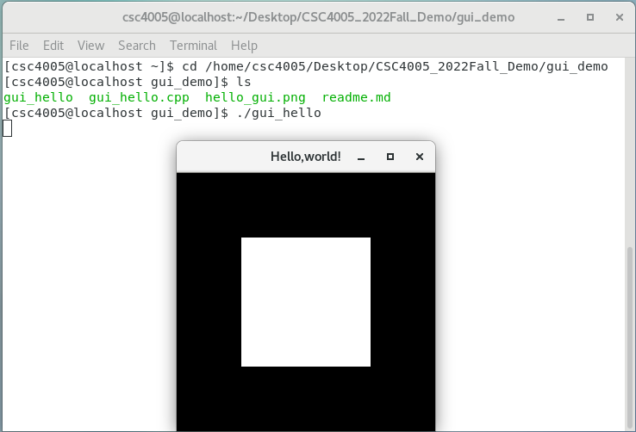
Run an executable
Go to a proper directory
Make sure you refer to the right executable
Some program are global (you have to add it to PATH env variable)

Slide 14
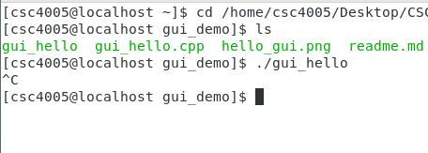
Interrupt a program
so it will kill itself:
Ctrl+C

Slide 15
Kill a process
pkill [process_name]
Kill -9 [pid]

Slide 16
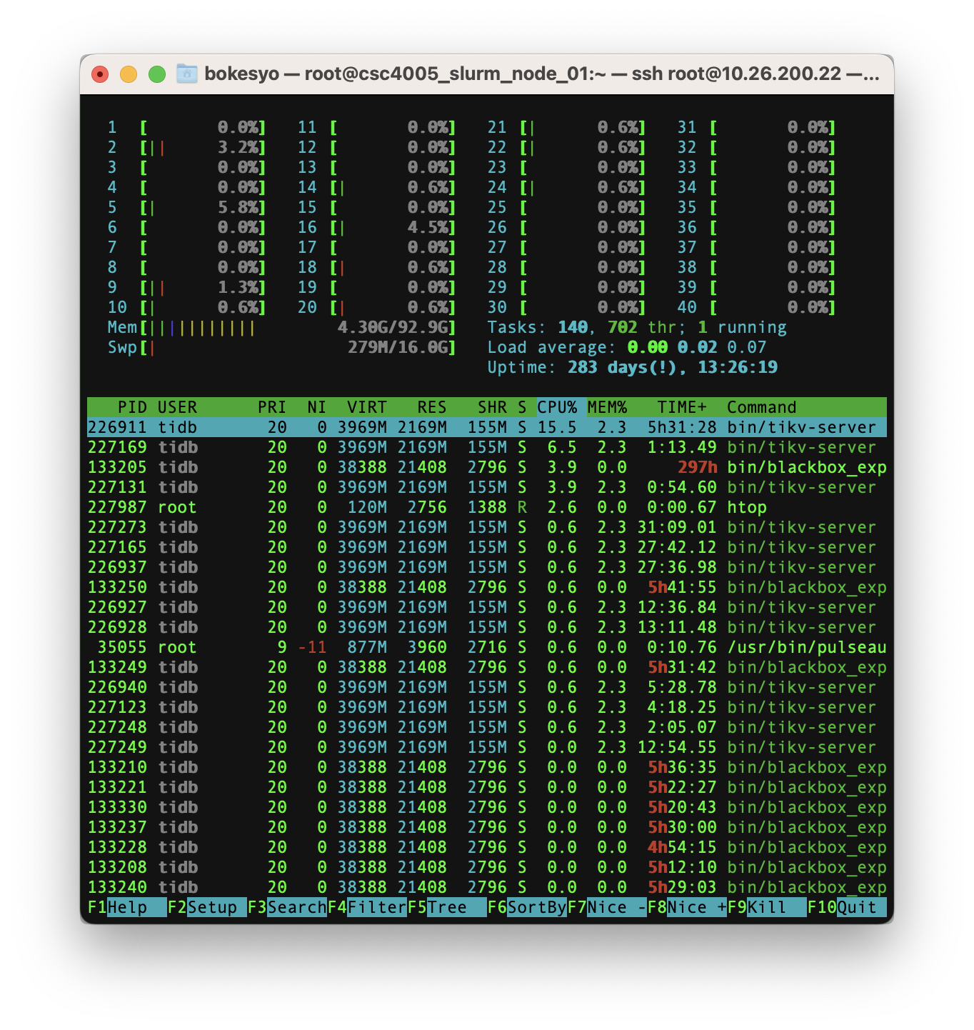
htop

Slide 17
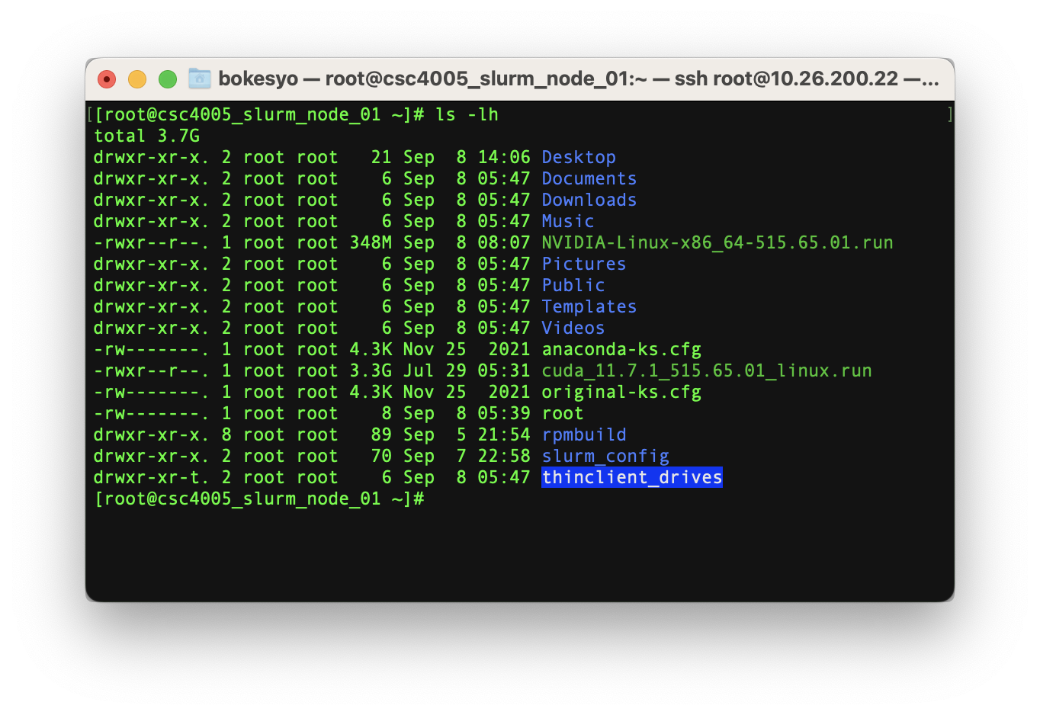
ls -lh

Slide 18
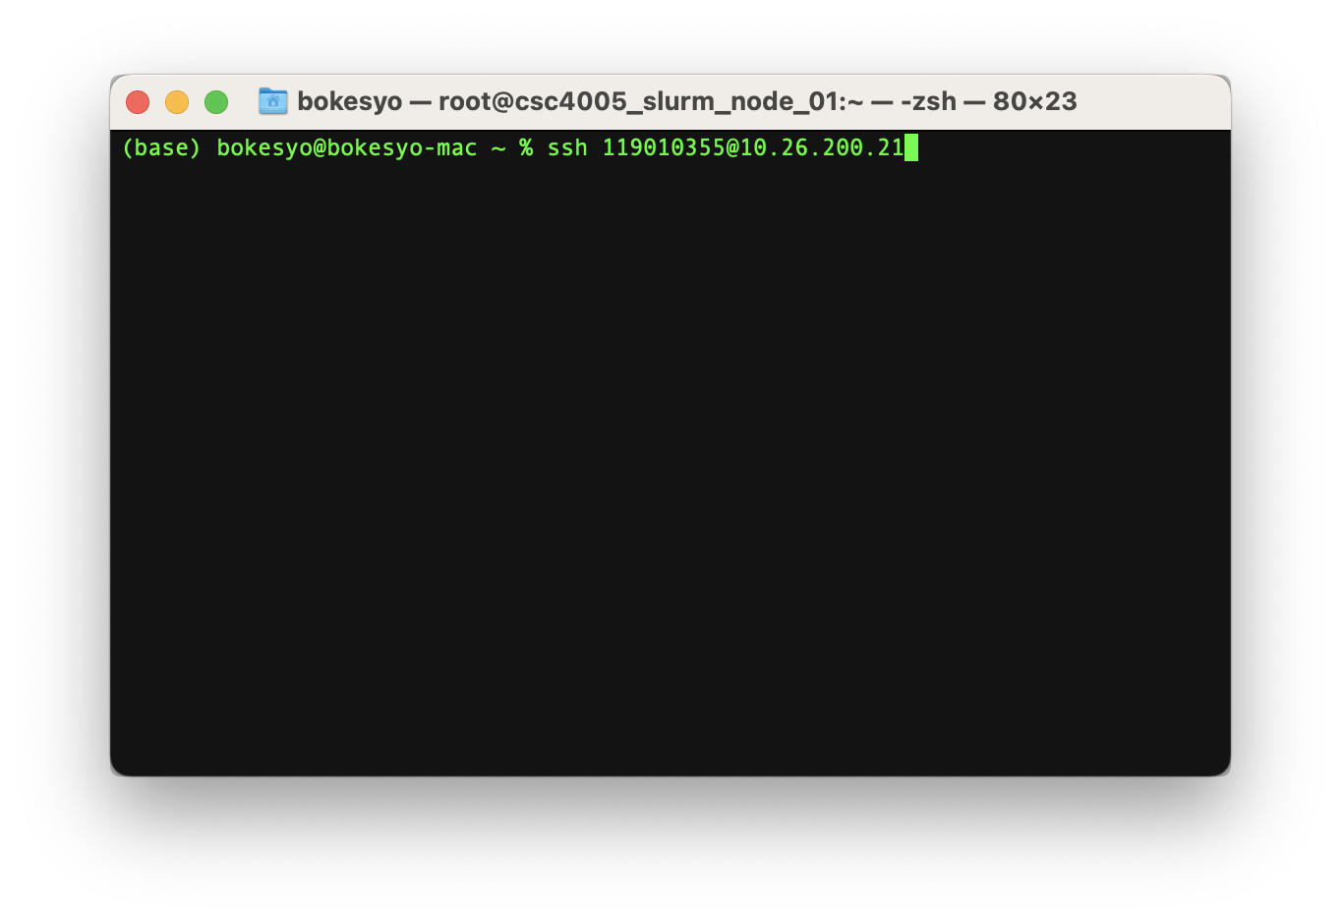
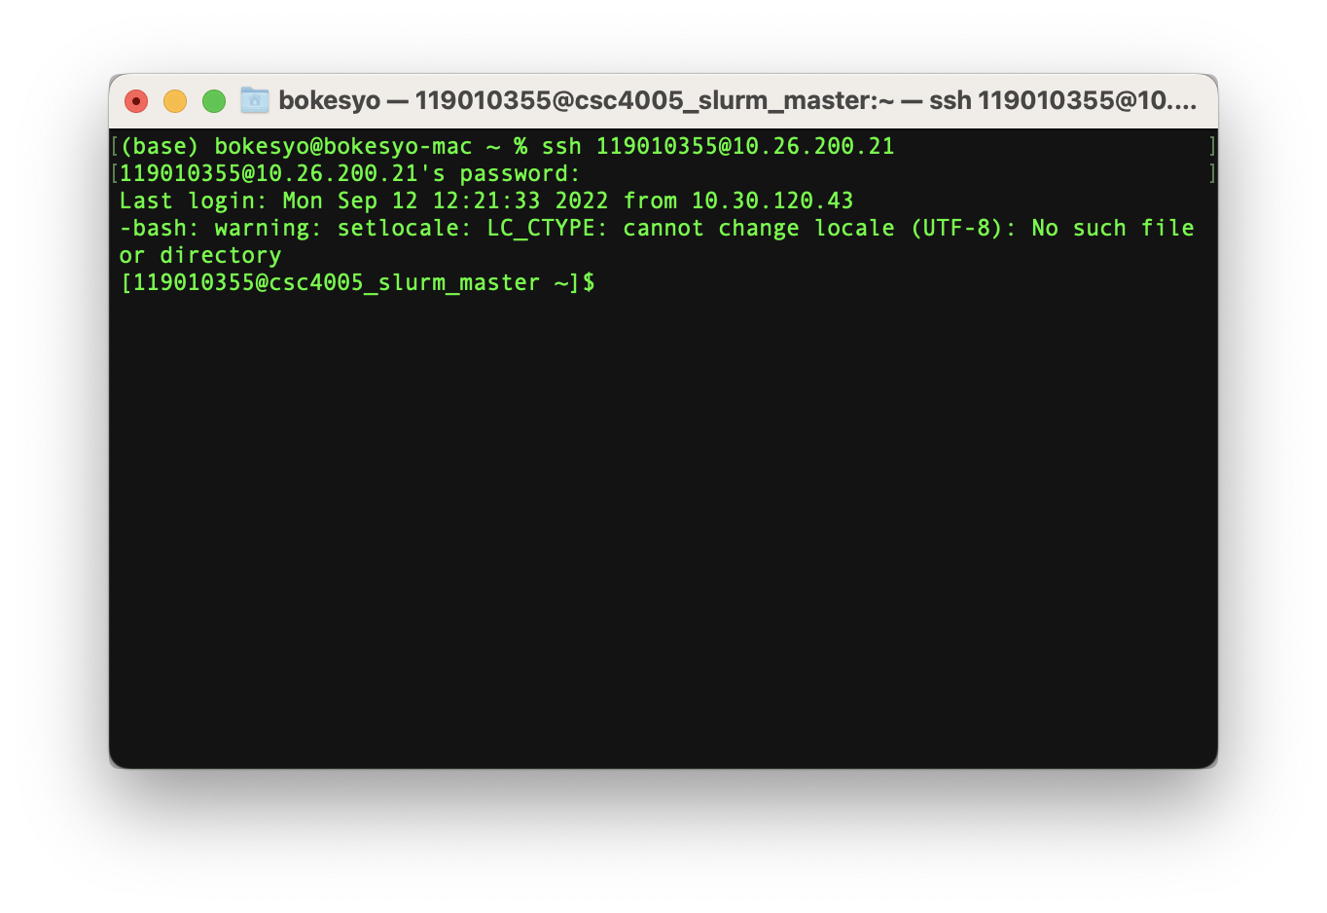
ssh
ssh [user]@[IP]

Slide 19
scp
Copy files from one machine to another.
scp [user]@[IP of remote machine]:[source file address on remote machine] [target file address on local machine]
scp [target file address on local machine] [user]@[IP of remote machine]:[source file address on remote machine]

Slide 20
Suggested Development Environment
 | MPI, pthreads, openMP, GUI | CUDA
If you are using Windows | Virtual Machine for coding and debug, ssh+HPC cluster for large scale experiment | ssh+HPC cluster for everything
If you are using Mac (intel chip) | Virtual Machine for coding and debug, ssh+HPC cluster for large scale experiment | ssh+HPC cluster for everything
If you are using Mac (Apple Silicon) | ssh+HPC cluster for everything | ssh+HPC cluster for everything

Slide 21
CSC4005 Virtual Machine Setup
You need a virtual machine software
For windows users:
You can use either VirtualBox (free) or VMware Workstation (paid)
For Mac (intel) users:
You can try VMware Fusion Player (free) or VirtualBox (free)
For Mac (Apple silicon) users:
You are suggested to use HPC cluster for everything (we will provide special guidance for you)

Slide 22
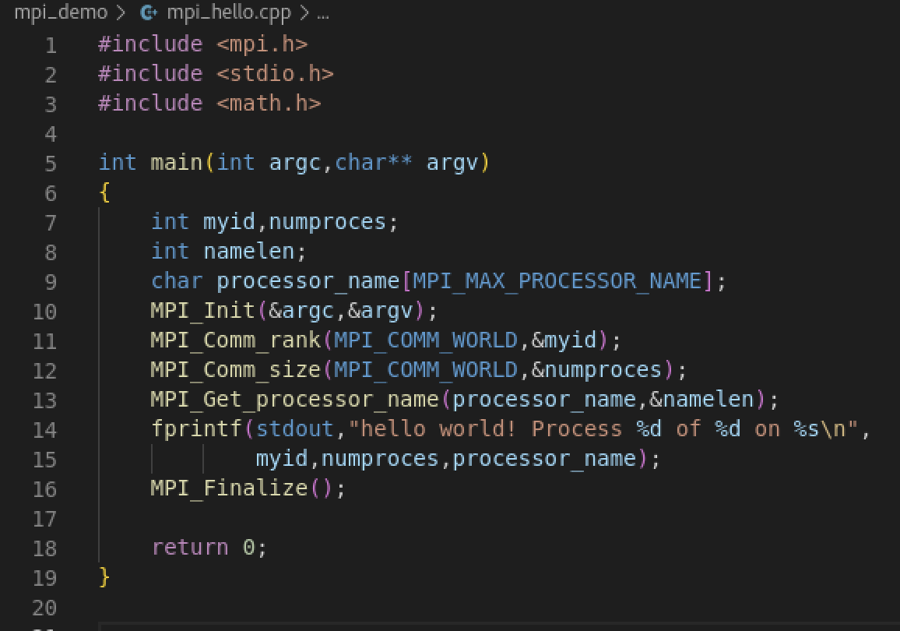
C++ libraries on linux
Compiling parallel programs requires external libraries (previously we only use C++ standard library in CSC3002)
Install external libraries
sudo yum install xxxx
Using external libraries
Include directory (.h):
/usr/include
Library directory (.so binary compiled code):
/usr/lib
/usr/lib64

Slide 23
C++ compilers on linux
Suggested: g++ (for both C and C++)
Function1: Compilation
Make your code binary code for CPU to execute.
Function2: Linking
Link your compiled program with external libraries (*.so) to make the program executable. Otherwise some functions will be undefined. Error will occurs.

Slide 24
C++ compilers for CSC4005
We will have four programming projects in CSC4005, all frameworks needed are listed here:
 | compiler
MPI | mpic++ | It is a wrapped g++ command
OpenMP, pthread | g++
GUI | g++
CUDA | nvcc
Hybrid Compilation (CUDA & C++) | nvcc & g++ -> g++ linker

Slide 25
C++ libraries on linux
Using external libraries
When you are writing your code, you have to include <mpi.h>
When you compile your mpi code, you should use mpic++ as compiler, it will help you find mpi.h and link mpi runtime to your program.
You can also use
g++ -m64 -O2 -g -pipe -Wall -Wp,-D_FORTIFY_SOURCE=2 -fexceptions -fstack-protector-strong --param=ssp-buffer-size=4 -grecord-gcc-switches -m64 -mtune=generic -fPIC -Wl,-z,noexecstack -I/usr/include/mpich-3.2-x86_64 -L/usr/lib64/mpich-3.2/lib -lmpicxx -Wl,-rpath -Wl,/usr/lib64/mpich-3.2/lib -Wl,--enable-new-dtags -lmpi

Slide 26
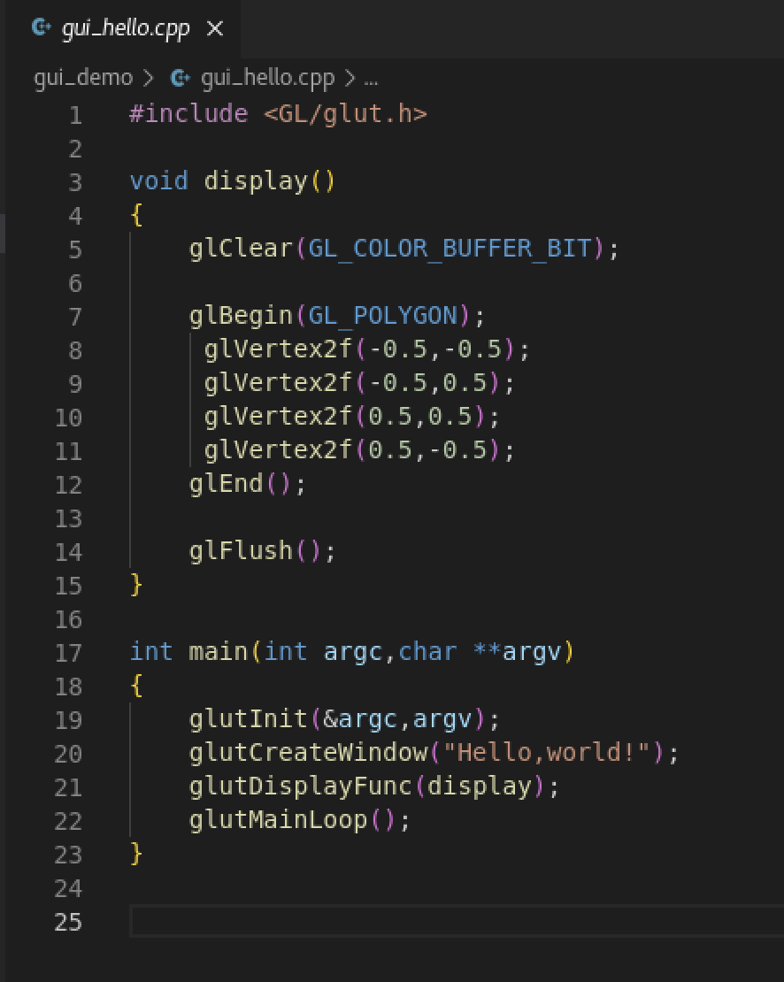
C++ libraries on linux
g++ -I/usr/include -L/usr/local/lib -L/usr/lib -lglut -lGLU -lGL -lm gui_hello.cpp -o gui_hello

Slide 27
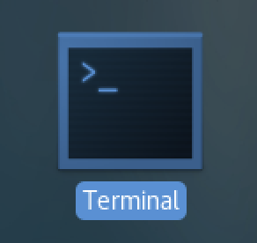
C++ parallel program compilation
You need to use CSC4005 VM or HPC cluster to compile.
If you have finsihed setting up your VM, open Terminal on your VM.
cd ~/Desktop/CSC4005_2022Fall_Demo/mpi_demo # switch to code folder
mpic++ mpi_hello.cpp -o mpi_hello # compile command

Slide 28
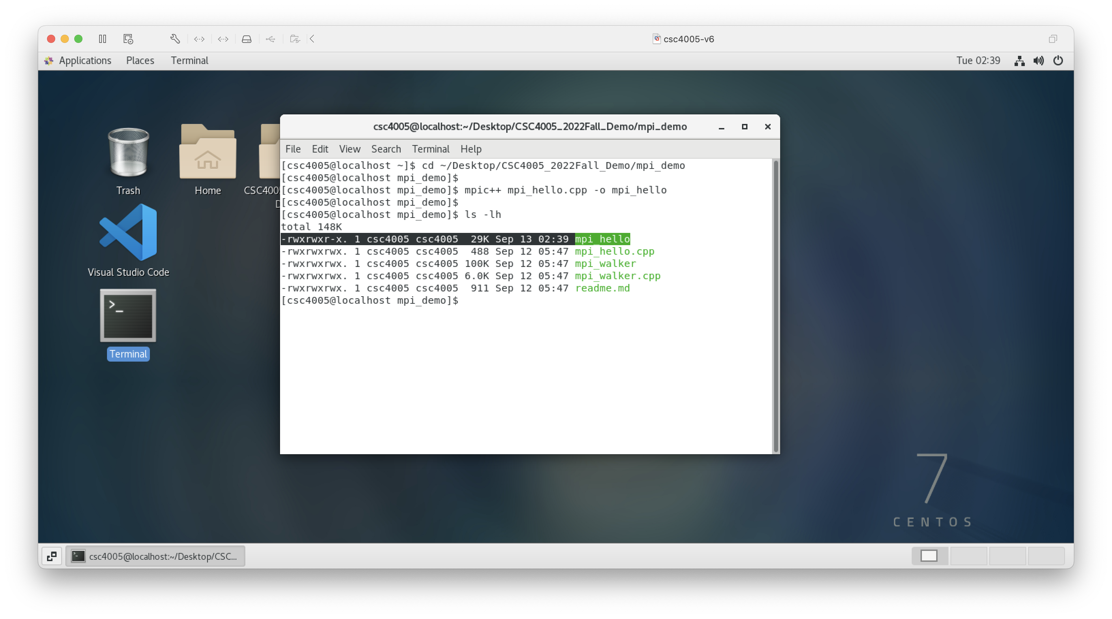

Slide 29
C++ parallel program compilation
For those students unable to run a VM, ssh to HPC clusters.
ssh 119010355@10.26.200.21 Password: csc4005
This is only a test account, we will distribute your normal account next week.
mkdir 119010355 # change to your student id
cd 119010355 # change to your student id
git clone https://github.com/bokesyo/CSC4005_2022Fall_Demo.git # download our demo script
chmod -R 777 CSC4005_2022Fall_Demo # make those files executable
cd CSC4005_2022Fall_Demo/mpi_demo # switch to code folder
mpic++ mpi_hello.cpp -o mpi_hello # compile command

Slide 30
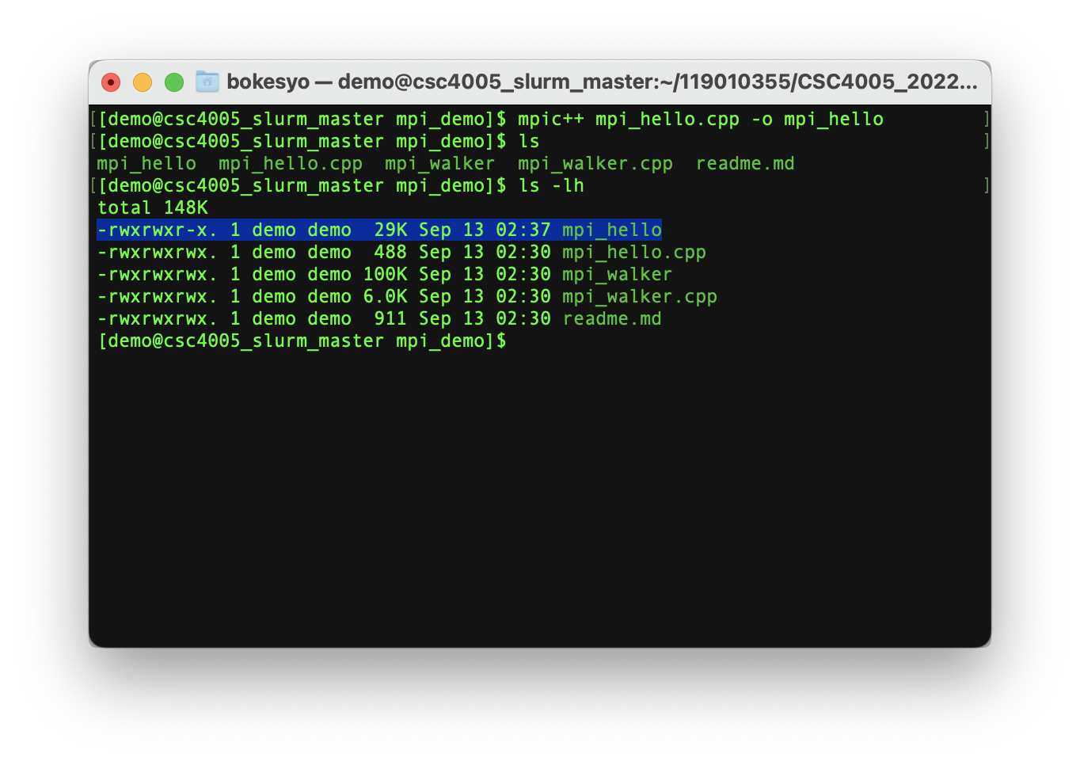

Slide 31
HPC cluster
Configuration
1 login node
20 Intel CPU cores (40 logic cores)
100GB RAM
1 Nvidia Quadro RTX 4000 GPU
30+ compute node
Each compute node has:
20 Intel CPU cores (40 logic cores)
100GB RAM
1 Nvidia Quadro RTX 4000 GPU

Slide 32
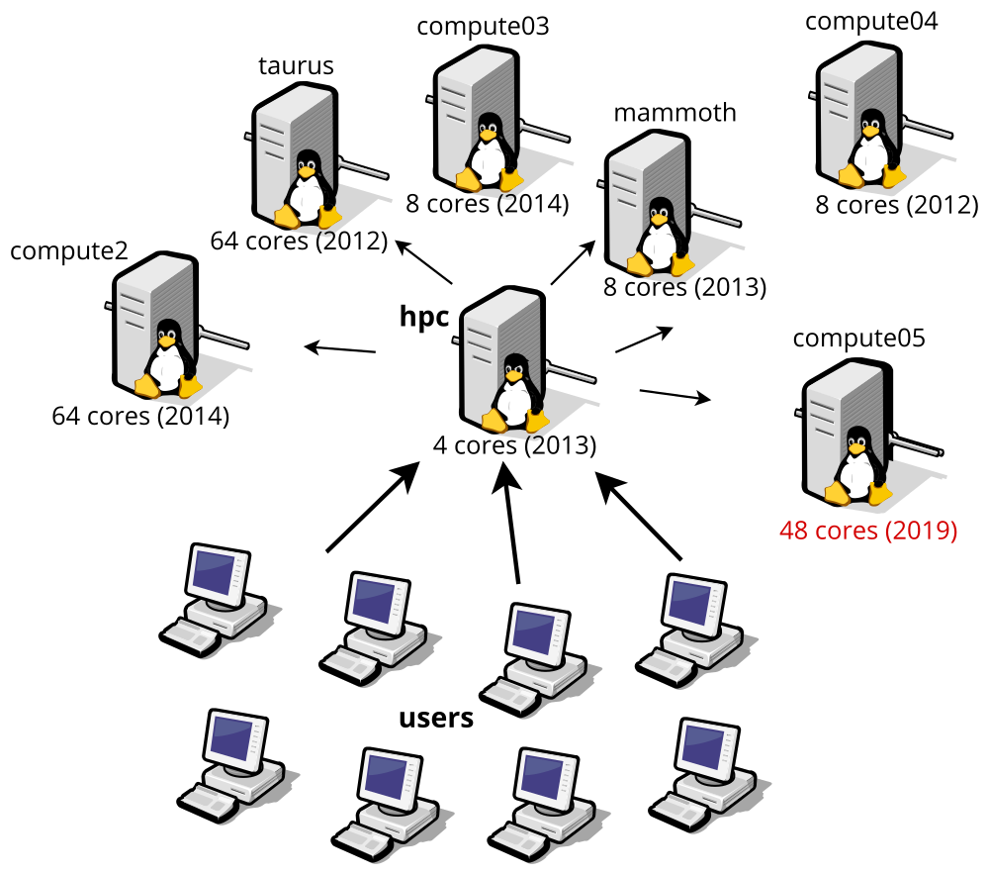
HPC cluster
Topology: one login node (controller) and 30+ compute node.
Cite: https://hpc.ilri.cgiar.org/using-the-cluster

Slide 33
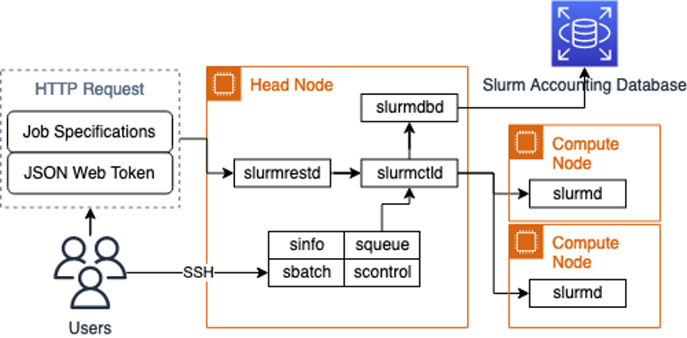
HPC cluster
Cite: https://aws.amazon.com/blogs/hpc/using-the-slurm-rest-api-to-integrate-with-distributed-architectures-on-aws/
Scheduler: slurm
Basic command:
sbatch
salloc
more on Tutorial 2
Underlying process:
Slurm transfers your shell script to compute node (same environment has been configured on each compute node and file system is shared, so your shell script can run on compute node). The output will be stored in a log file. Slurm will reserve the resources you applied for your parallel programs.
A parallel program can create many processes on the same machine (processes communicate on the same machine) or on multiple machines (processes communicate by local networks)

Slide 34
HPC cluster
Login node is for you to:
Use file system (store your code and other files)
Debug your code
Compile your code
Apply for resources and create computing jobs using slurm
Normal users cannot directly access compute node.

Slide 35
HPC cluster
Your personal file directory
/nfsmnt/[your student id]/
You can access your personal files by using that directory on each compute node in the cluster

Slide 36
Run your C++ parallel programming on VM or HPC cluster
For those students who can use VM:
mpirun -np 4 ./mpi_hello
For those students unable to run a VM: continue to use the compiled program
salloc -n4 # request 4 cores on compute nodes
mpirun -np 4 ./mpi_hello

Slide 37
